Slide 1
An Introduction to Structure-based cheminformatics: data clustering & visualization, read across and predictive modeling. Accessing data through the US-EPA CompTox Chemicals Dashboard
Antony John Williams
U.S Environmental Protection Agency (EPA)
Office of Research and Development (ORD)
Research Triangle Park, North Carolina
919-541-1033
williams.antony@epa.gov

Slide 2
Conflict of Interest Statement
The author declares no conflict of interest.
The views expressed in this presentation are those of the author and do not necessarily reflect the views or policies of the US EPA.

Slide 3
Abbreviations
CompTox - Computational Toxicology
DSSTox - Distributed Structure Searchable Toxicity DB
CASRN - Chemical Abstracts Registry Number
InChI - International Chemical Identifier
QMRF – QSAR Model Report Format
ToxVal - Toxicity Value Database
OPERA - OPEn structure–activity Relationship App
TEST - Toxicity Estimation Software Tool
ToxCAST - Toxicity Forecaster
SDF - Structure data file

Slide 4
Learning Objectives
A very short overview of cheminformatics focused on
Chemical identifiers and some associated challenges
Molecular fingerprints
Molecular similarity
Structure-based modeling (QSAR/QSPR/QSUR)
An overview of the CompTox Chemicals Dashboard and how it can help to:
Search, source, visualize and download data for singleton or thousands of chemicals
Perform real-time prediction calculations and read-across
Navigate into dozens of other online resources that contain additional data

Slide 5
Problem: Too Many Chemicals and Too Few Resources
Fast characterization of human and ecological risk posed by existing and emerging chemicals is a critical challenge
Chemistry never stops. But there is sparse and distributed data…
Data for Environmental Chemicals
70
60
50
40
30
20
10
0
Percent of Chemicals
CAS REGISTRY® contains more than 171 million unique organic and inorganic chemical substances, such as alloys, coordination compounds, minerals, mixtures, polymers and salts, and more than 68 million protein and DNA sequences
<1%
Acute
Gentox
Cancer
Dev Tox
Repro Tox
Modified from Judson et al., EHP 2010
EDSP Tier 1

Slide 6
Solution
Develop a “first-stop-shop” for environmental chemical data to support EPA and partner decision making:
Centralized location for relevant chemical data
Chemistry, exposure, hazard and dosimetry
Combination of existing data and predictive models
Publicly accessible, periodically updated, curated
Easy access to data improves efficiency and ultimately accelerates chemical risk assessment

Slide 7
Cheminformatics and the Dashboard
Cheminformatics is the application of computer science and informatics-based approaches to:
Represent chemical structures, substances and reactions
Store chemistry-related data
Search for chemistry related data
Model data sets to provide predictive capabilities
Visualize and analyse chemistry related data
The US-EPA uses cheminformatics (and bioinformatics) to manipulate, integrate, store, model and deliver access to our data. The CompTox Chemicals Dashboard is built on a solid cheminformatics foundation
Notes:
From Two neologisms, “chemoinformatics” and “cheminformatics”, presently occur with near-equal frequency as a search in the database of the Chemical Abstracts Service reveals. In the following the term “chemoinformatics” will be used without providing extensive justification but to show the linguistic relation to bioinformatics
Definition is a summary of Engel, although very broad topic
Mostly applied, historically in drug design – now increasingly used in toxicology as well
[NB searching data includes similarity as we will look at in this ppt)

Slide 8
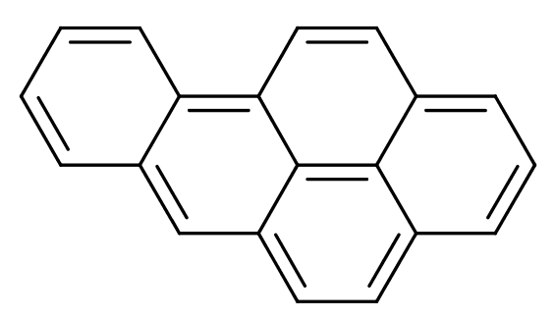
Types of Chemical Identifiers
Structural Identifiers
The visual depiction
Multiple electronic formats
InChI (Key): FMMWHPNWAFZXNH-UHFFFAOYSA-N
Common Name: Benzo(a)pyrene
Systematic Name: Benzo[pqr]tetraphene
CAS Registry Number(s) : 50-32-8
Lots of other “common names and trade names”

Slide 9
Information Associated with a Chemical Structure?
INTRINSIC PROPERTIES
Formula : C₂₀H₁₂
Molecular weight: 252.316 g/mol
Monoisotopic Mass: 252.093900 g/mol
MEASURED PROPERTIES
LogKow 6.13
Melting Pt 177°C
Boiling Pt 485°C
….and many more
Notes:
https://en.wikipedia.org/wiki/Flutamide
Numbers of atoms
Properties from epa dashboard

Slide 10
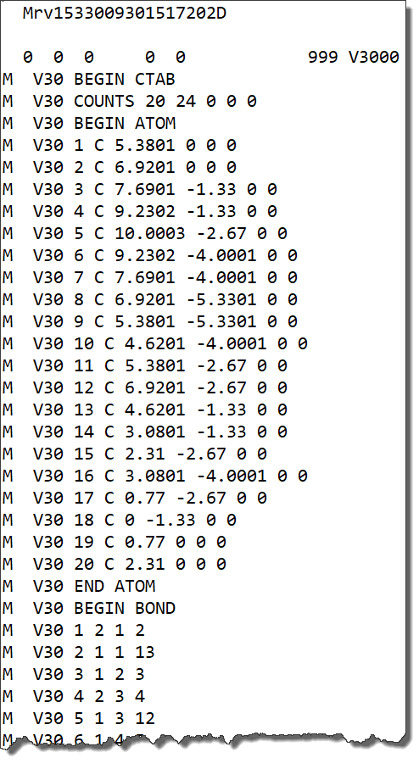
How to Store a Chemical Structure
Multiple approaches:
Names and identifiers
2D or 3D structure “molfile”
SMILES:
c1cc2c3ccc4cccc5ccc(cc2cc1)c3c45
C1=CC2=CC3=CC=C4C=CC=C5C=CC(=C2C=C1)C3=C45
and many other variants….
InChI=1S/C20H12/c1-2-7-17-15(4-1)12-16-9-8-13-5-3-6-14-10-11-18(17)20(16)19(13)14/h1-12H
InChIKey: FMMWHPNWAFZXNH-UHFFFAOYSA-N
Notes:
Because we can
https://en.wikipedia.org/wiki/Flutamide
NB. We cannot store the chemical structure as it is written
MKXKFYHWDHIYRV-UHFFFAOYSA-N is Inchikey
Those of us who remember the world before SMILES, still appreciate its beauty!
Many methods make chemical structure machine readable
Convenience – don’t need to go through paper files
Sustainability - (in theory at least) permanent storage
Transferability - (in theory at least) anyone in world can view and retrieve data

Slide 11
If We Database Chemical Structures…
…then we can search the dataset by inherent structural properties
Formula
Mass
Substructure
Structural similarity
…we can integrate other info into the database for retrieval
…available data, both experimental and predicted, is a click away
…data can be downloaded, distributed and shared
…linking out to other resources is enabled by adopting specific standards
…structure collections, with associated data, are available for modeling
Notes:
Because we can
https://en.wikipedia.org/wiki/Flutamide
Many methods make chemical structure machine readable
Convenience – don’t need to go through paper files
Sustainability - (in theory at least) permanent storage
Transferability - (in theory at least) anyone in world can view and retrieve data

Slide 12
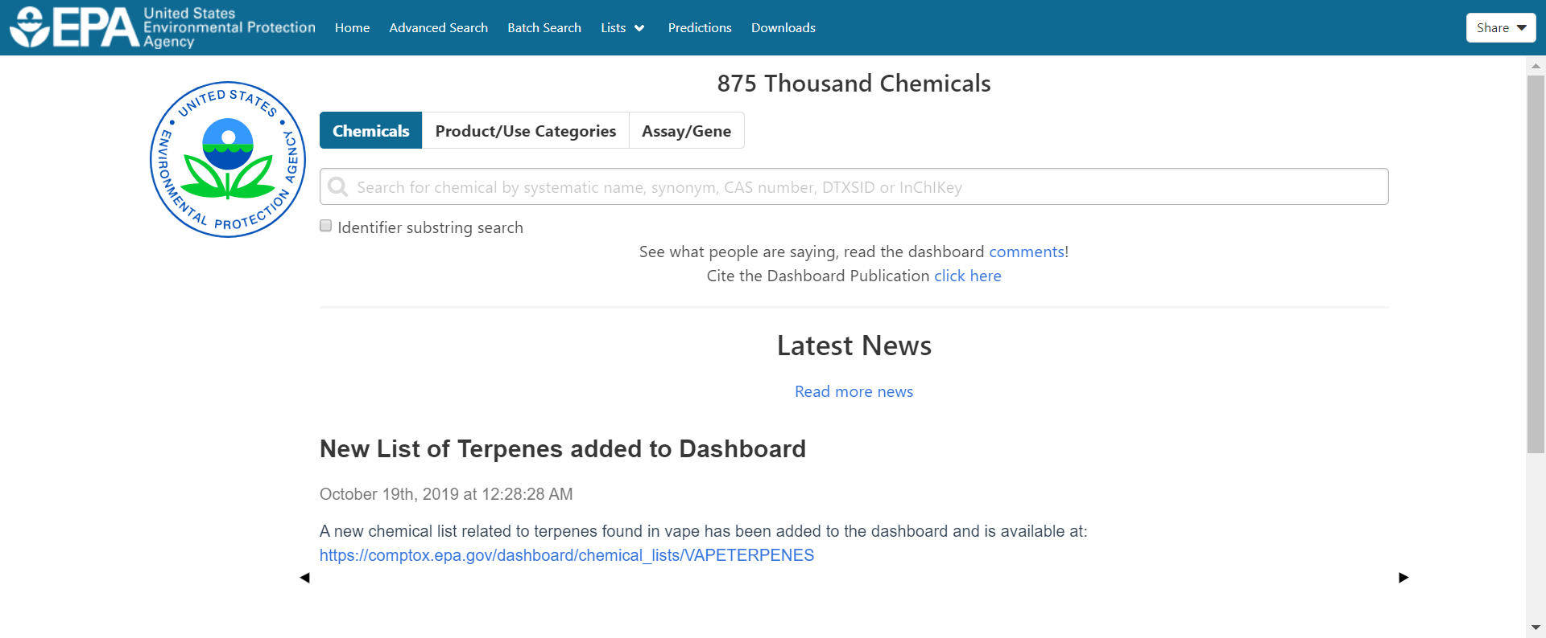
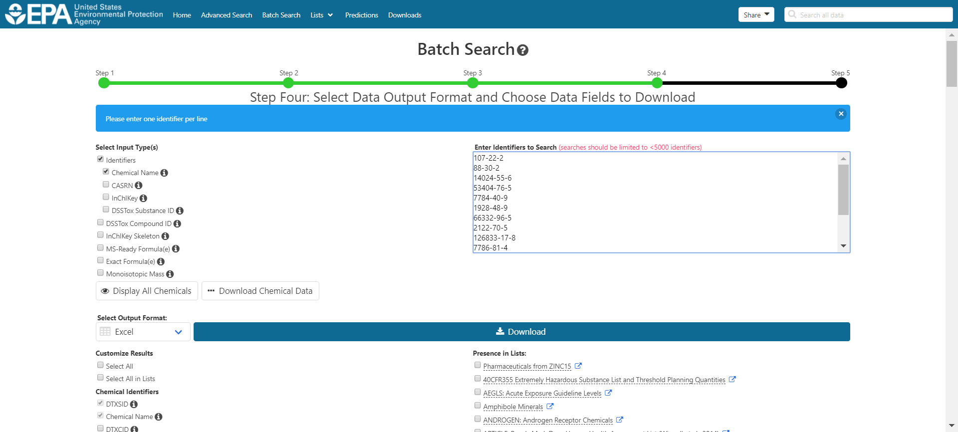
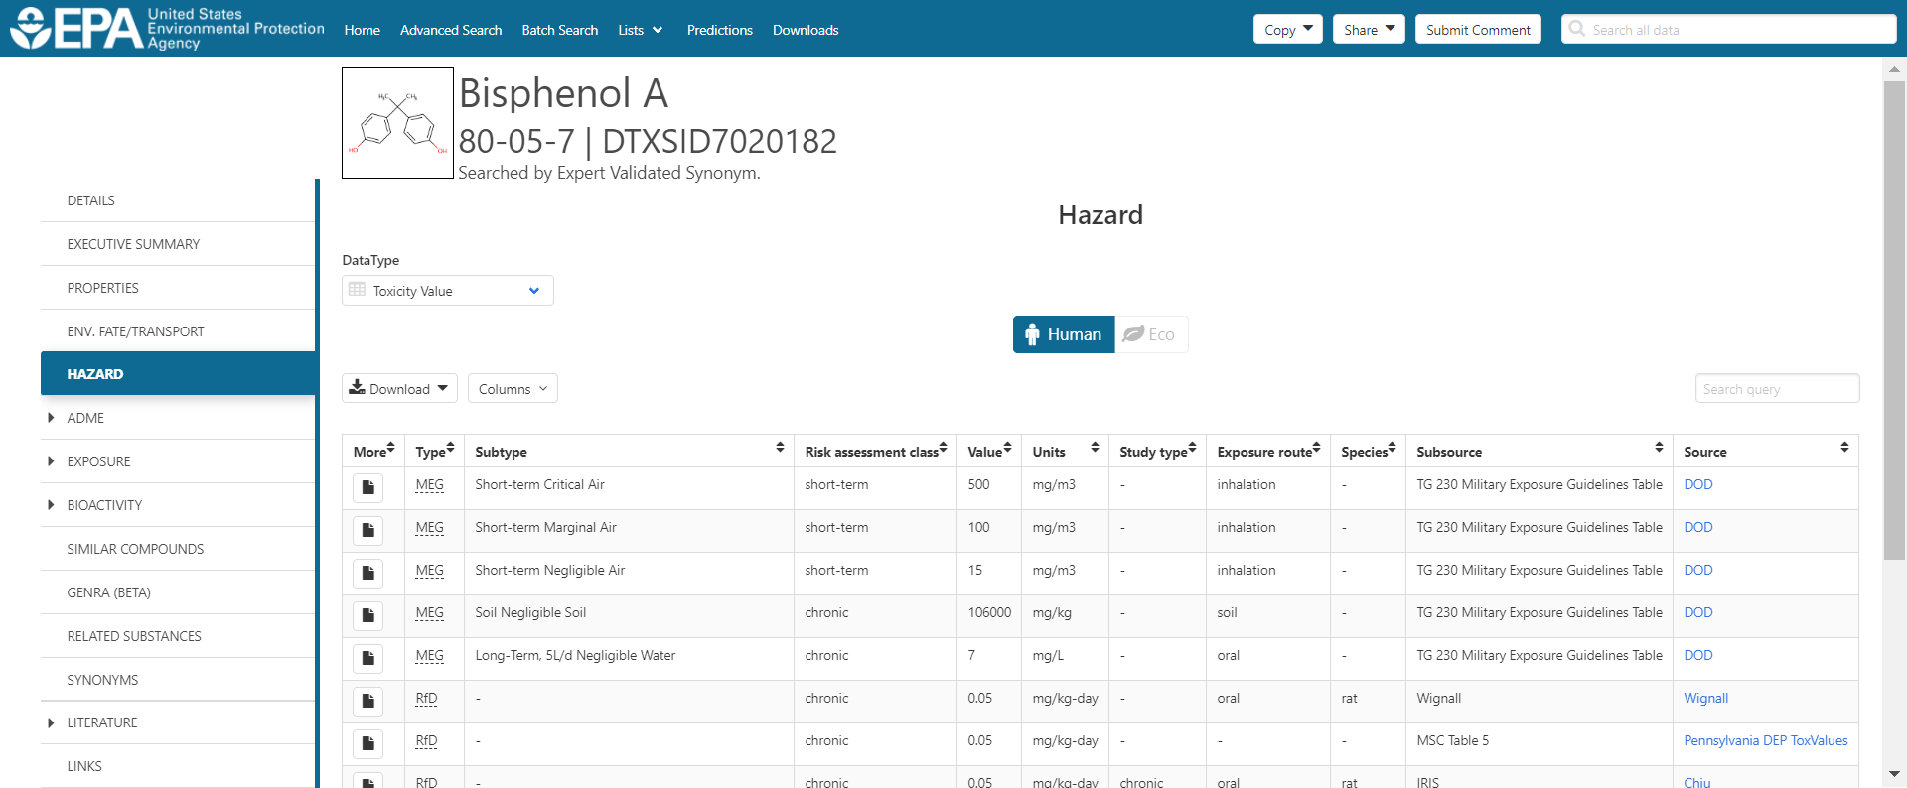
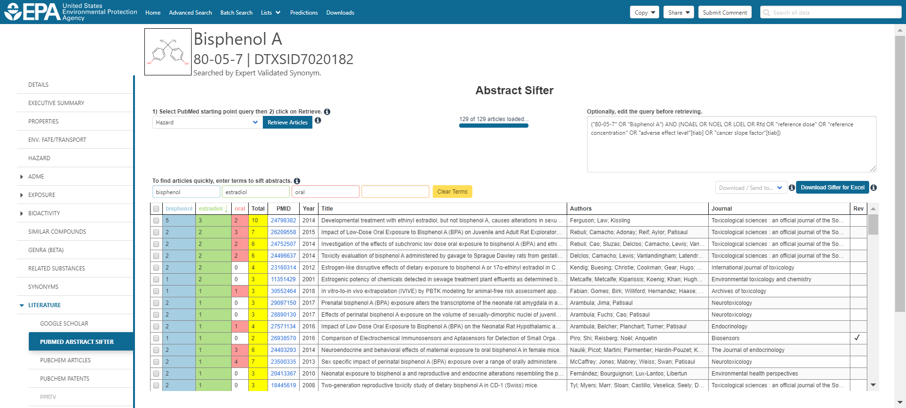
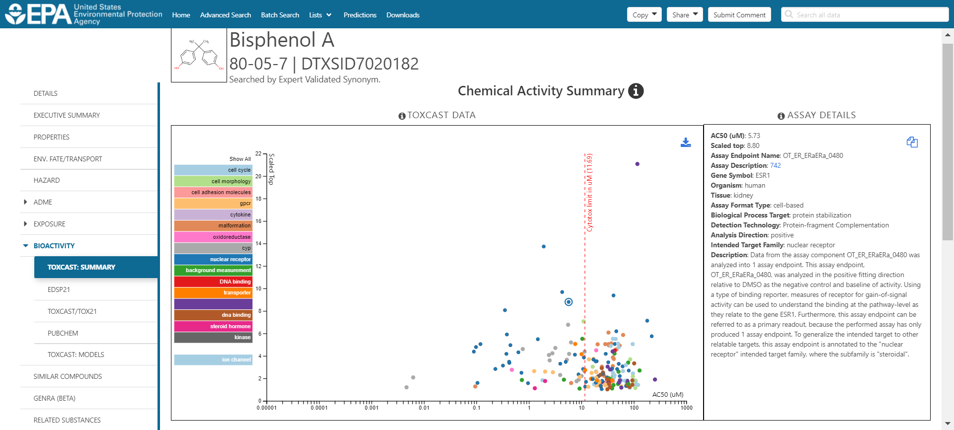
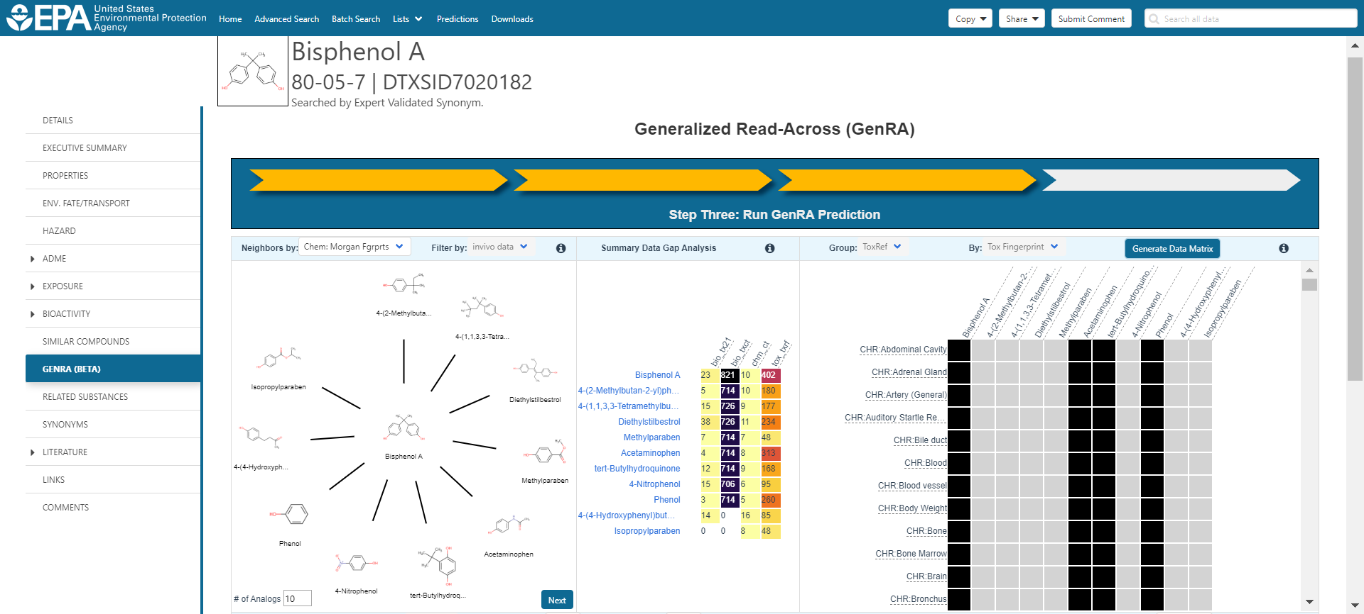
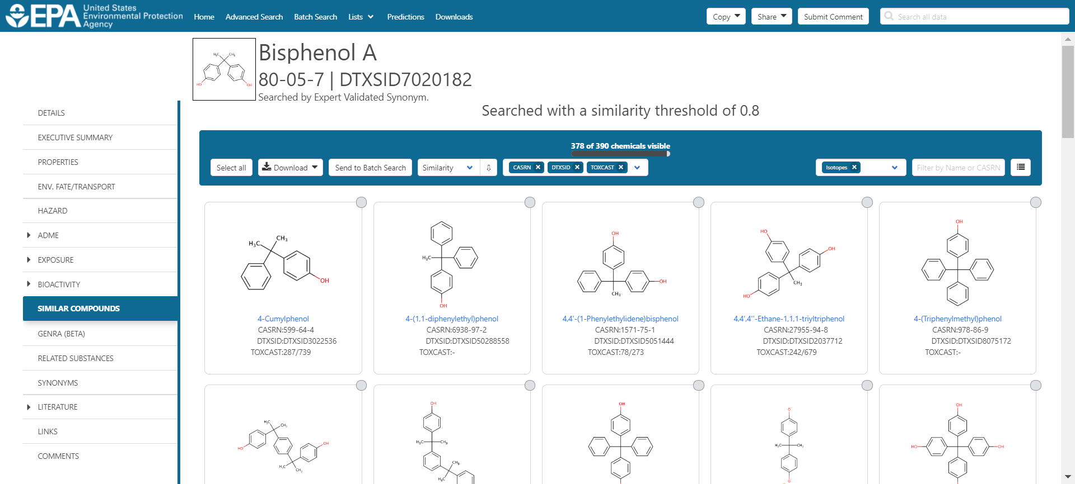
CompTox Chemicals Dashboard https://comptox.epa.gov/dashboard
SEARCH
BATCH SEARCH
TOX DATA
PUBMED
BIOACTIVITY
READ-ACROSS
SIMILARITY

Slide 13
CompTox Chemicals Dashboard
883k Chemical Substances

Slide 14
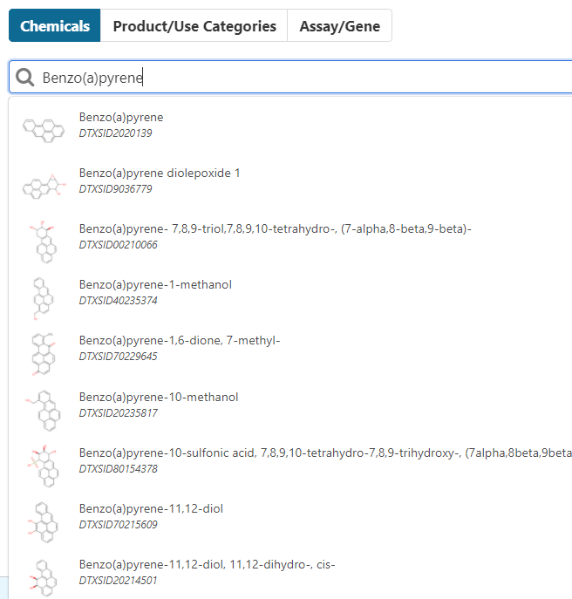
BASIC Search
Type ahead search using Names, synonyms and CASRNs
Millions of identifiers
Substring search

Slide 15
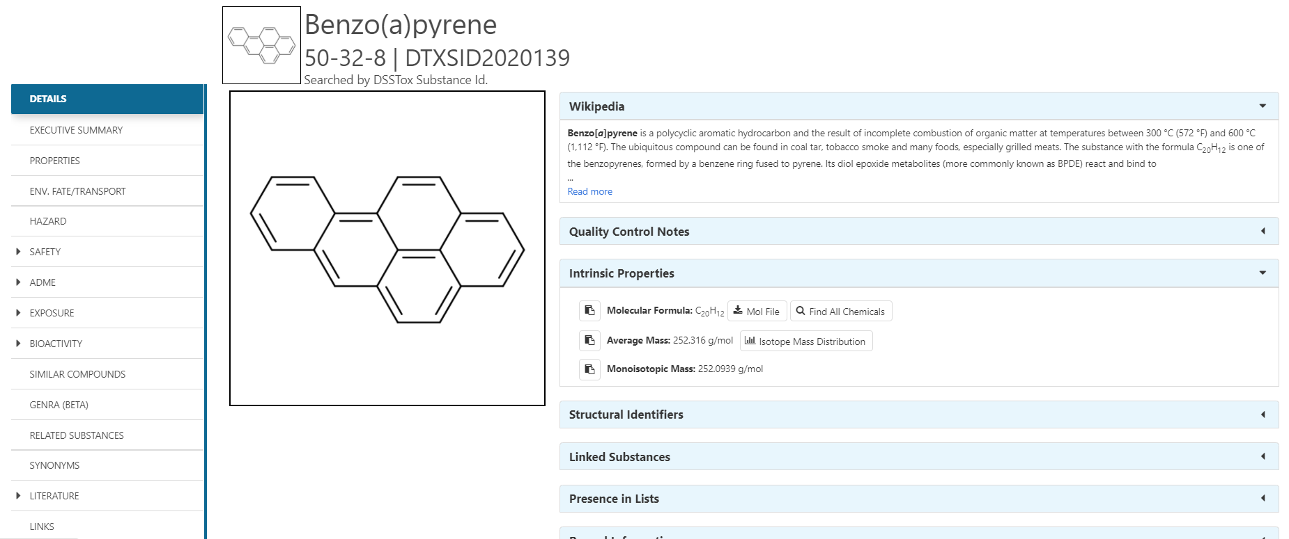
Detailed Chemical Pages One more identifier – the DTXSID
Chemical page: Wikipedia snippet when available, intrinsic properties, structural identifiers, linked substances

Slide 16
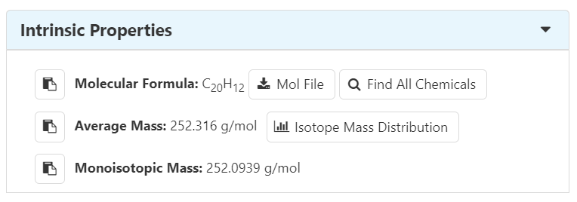
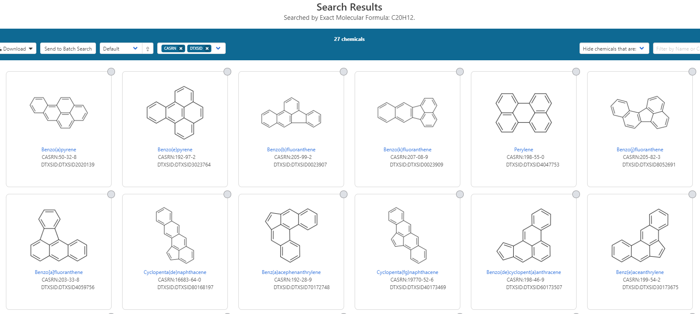
From the Chemical Details Page…

Slide 17
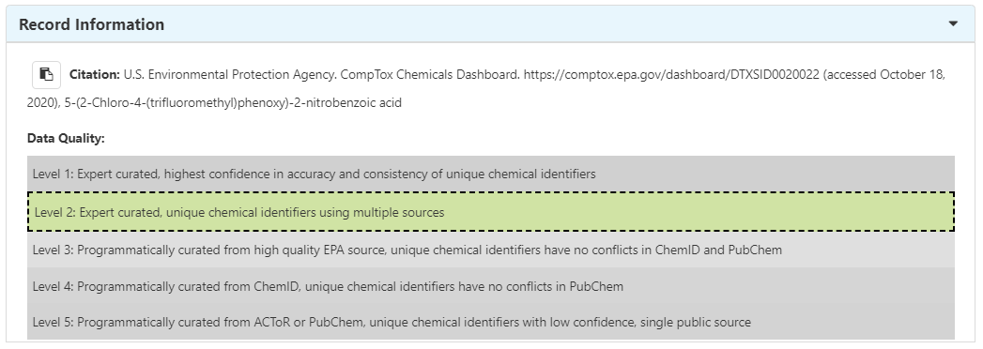
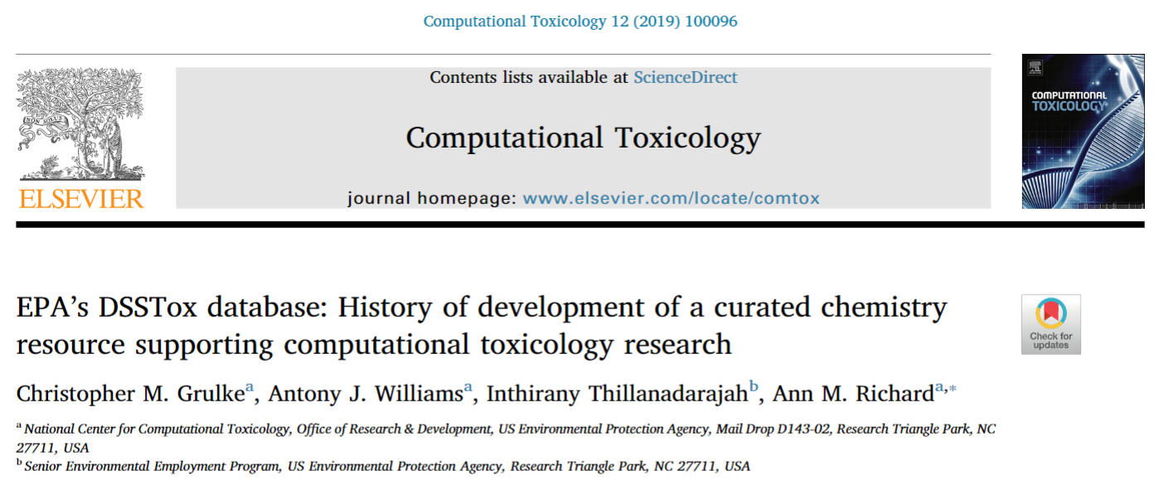
Quality
Five full time curators register and curate data to elevate quality

Slide 18
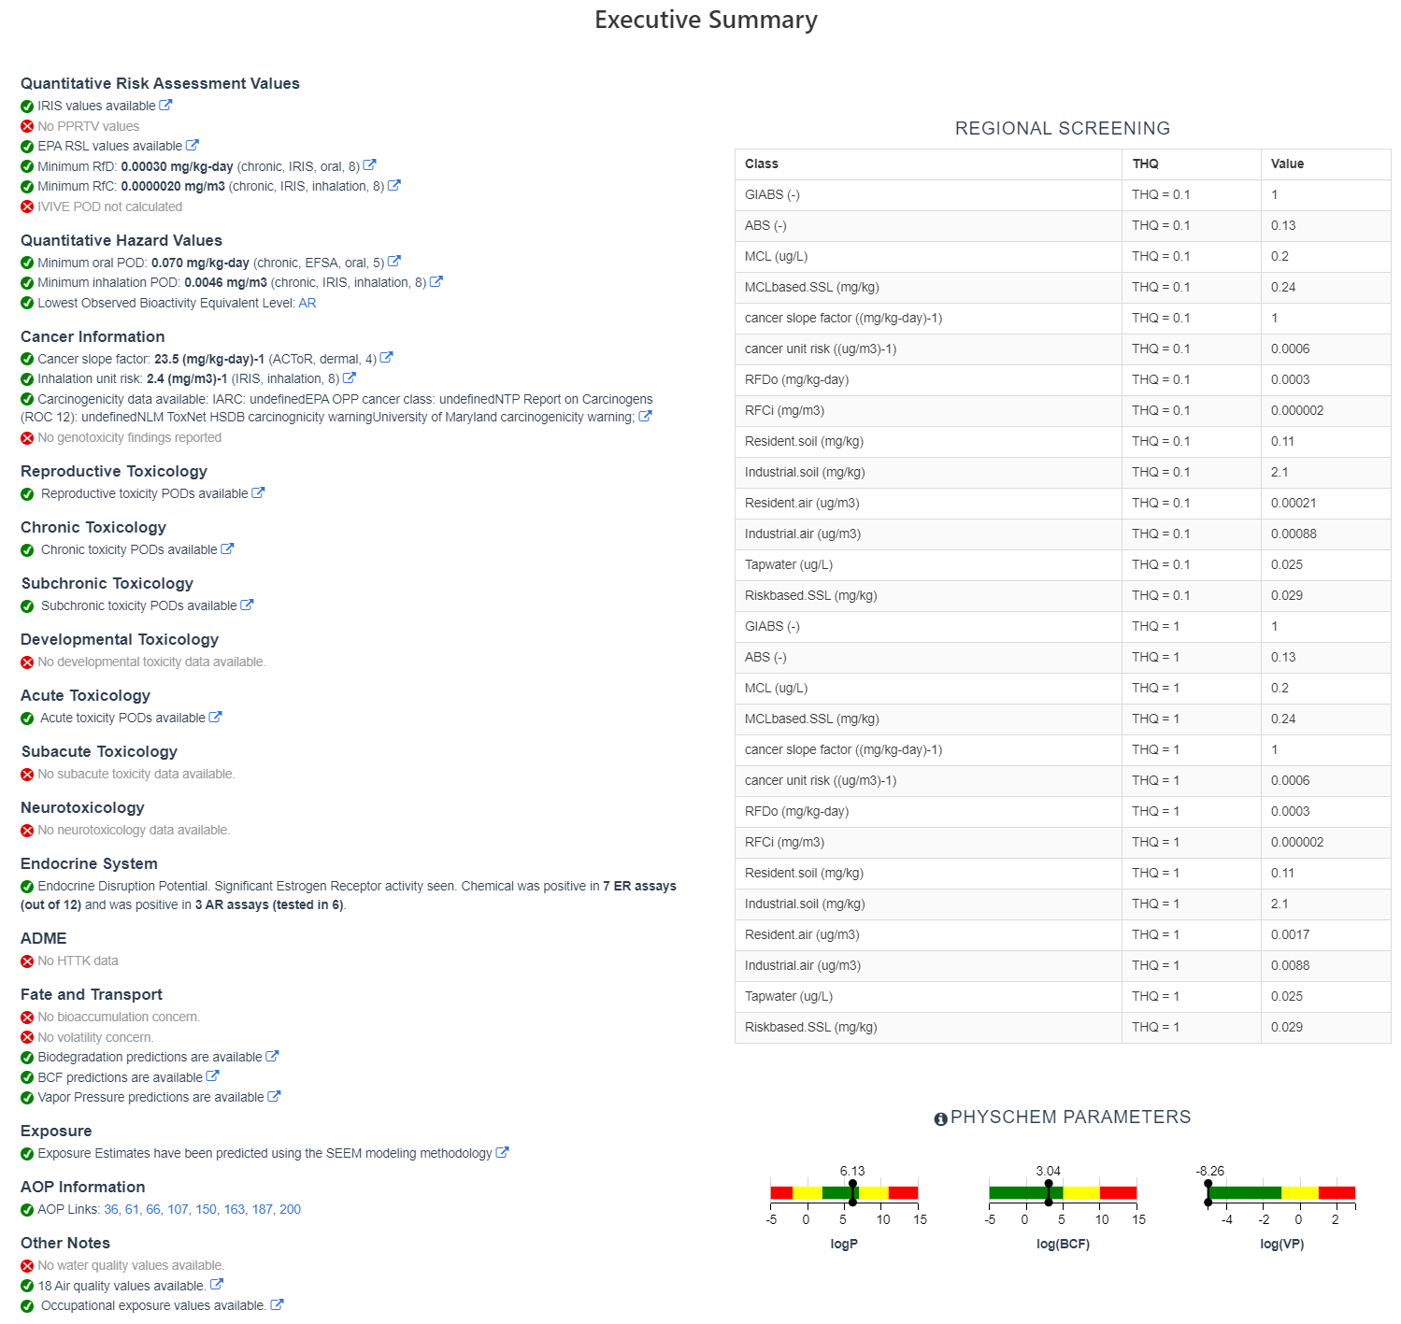
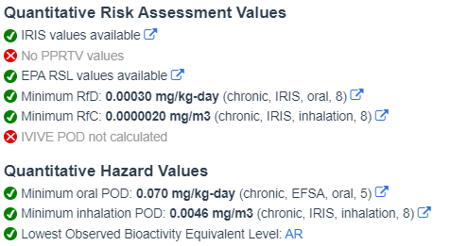
“Executive Summary”
Overview of toxicity-related info
Quantitative values
Info re. toxicology subsets
Physchem. and Fate & Transport
Adverse Outcome Pathway links
In vitro bioactivity summary plot

Slide 19
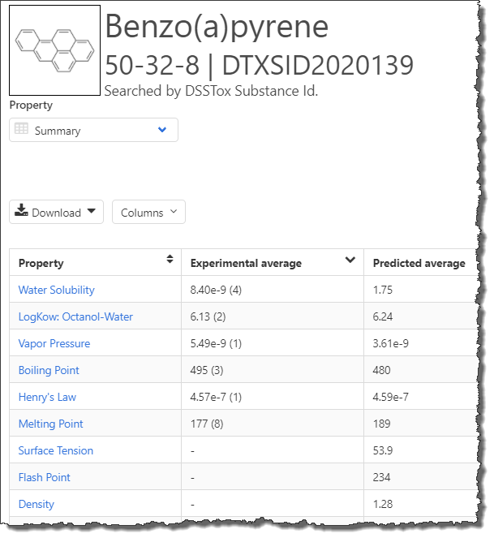
Experimental and Predicted Data
Physchem and Fate & Transport experimental and predicted data
Data can be downloaded as Excel, TSV and CSV files
Predictions: multiple algorithms
EPI Suite: Estimation Program Interface
ACD/Labs (commercial)
TEST: Toxicity Estimation Software Tool
OPERA: OPEn structure–activity/ property Relationship App

Slide 20
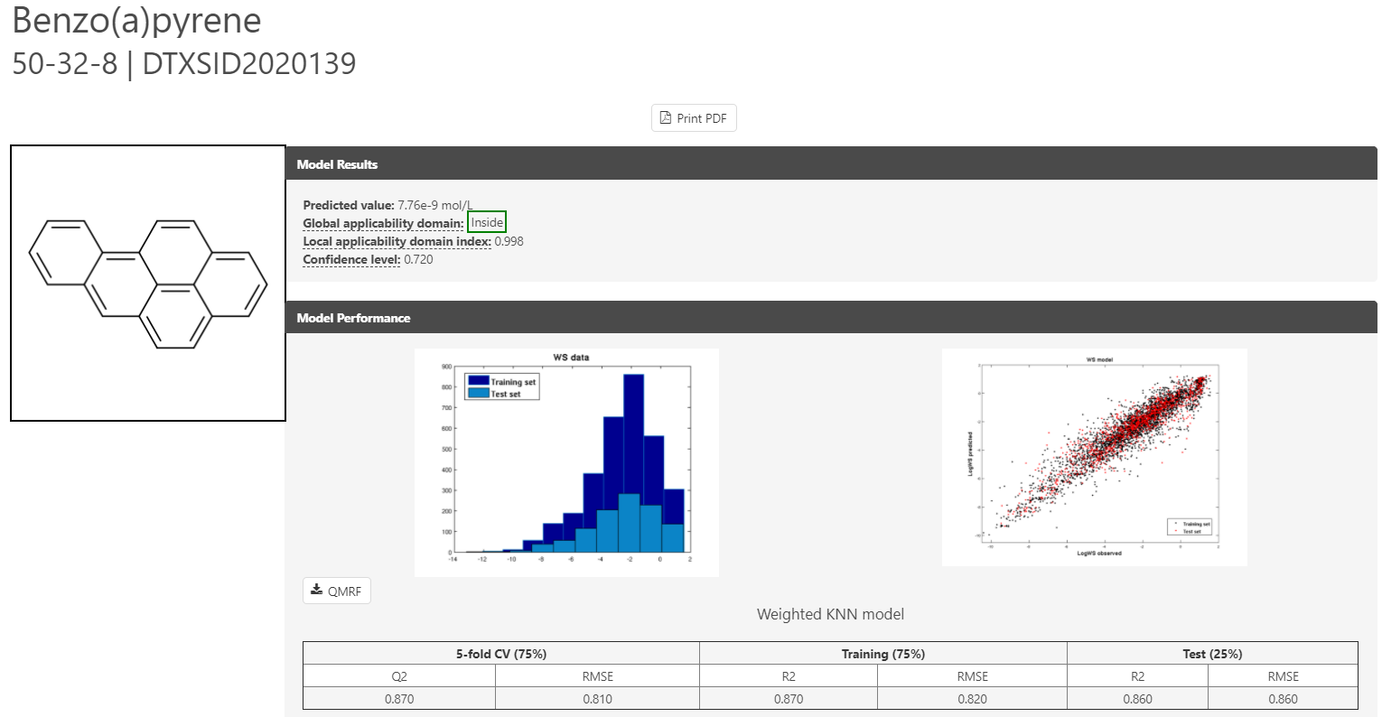
Transparency for prediction models
QMRF – QSAR Model Report Format details
Applicability Domain
Plots of expt. vs pred.
Nearest-neighbors

Slide 21
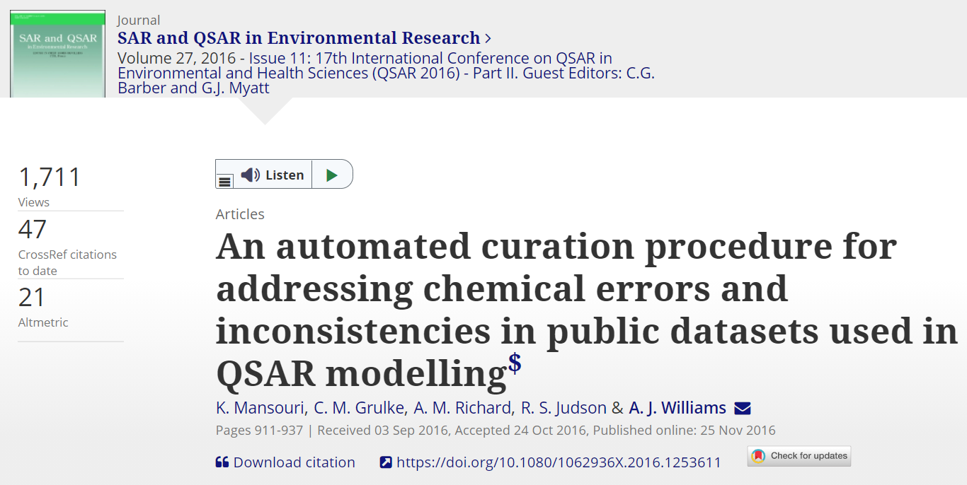
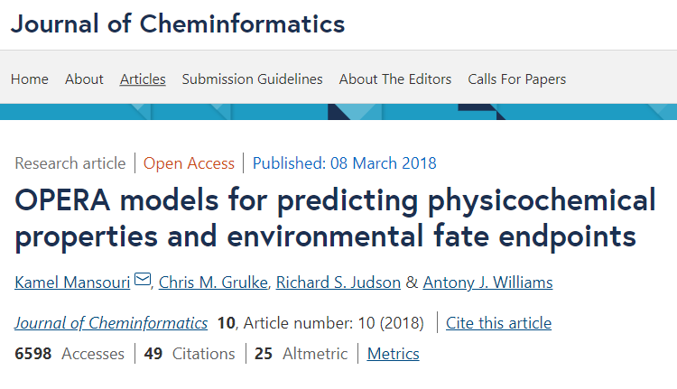
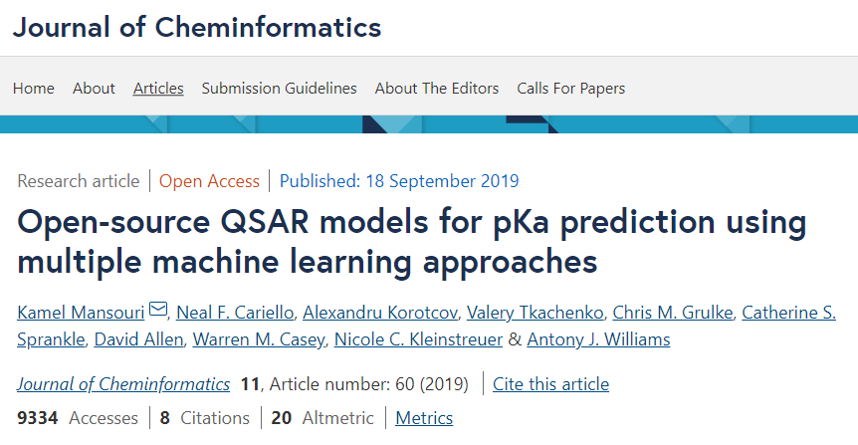
OPERA Models

Slide 22
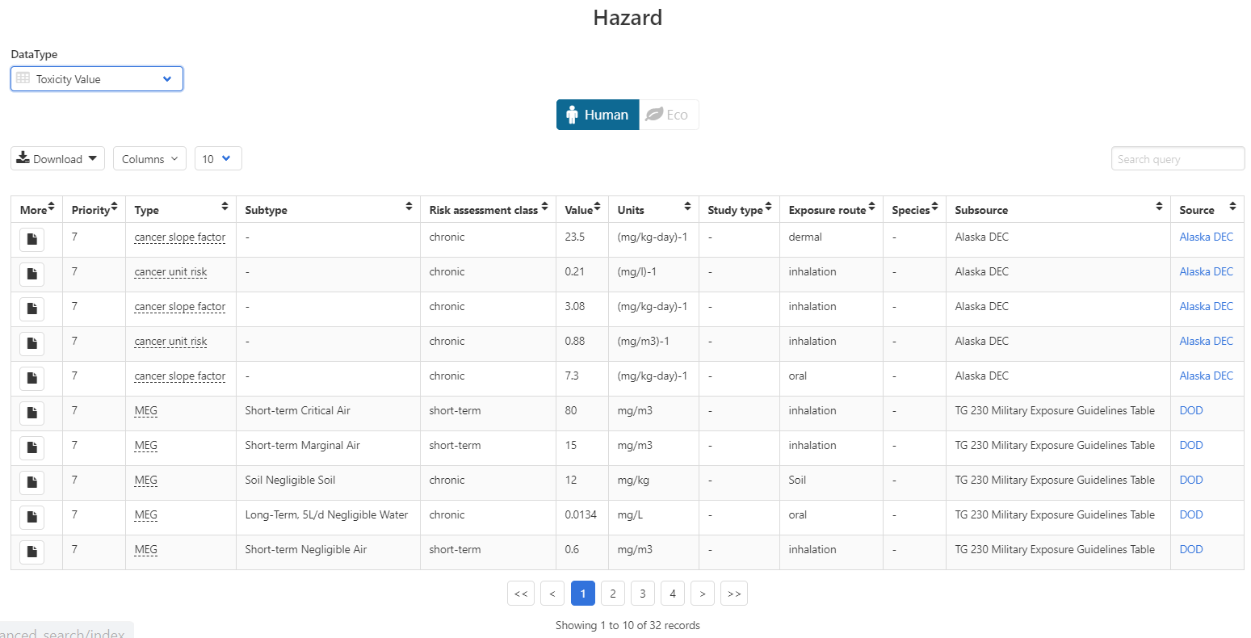
Chemical Hazard Data
ToxVal Database
~30k chemicals
>770k tox. values
~30 sources of data
~22k sub-sources
~5k journals cited
~70k citations

Slide 23
Safety Data

Slide 24
Sources of Exposure to Chemicals

Slide 25
Identifiers to Support Searches

Slide 26
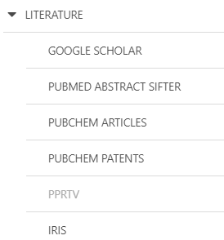
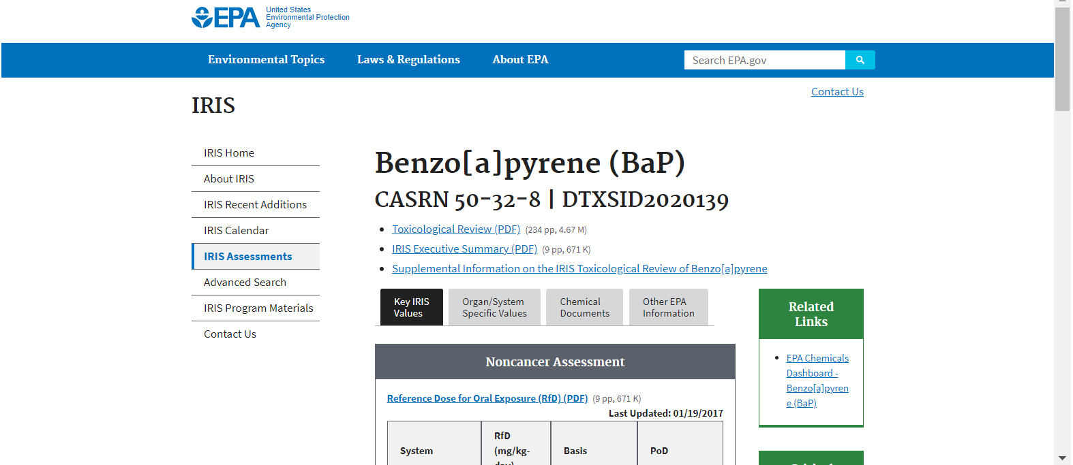
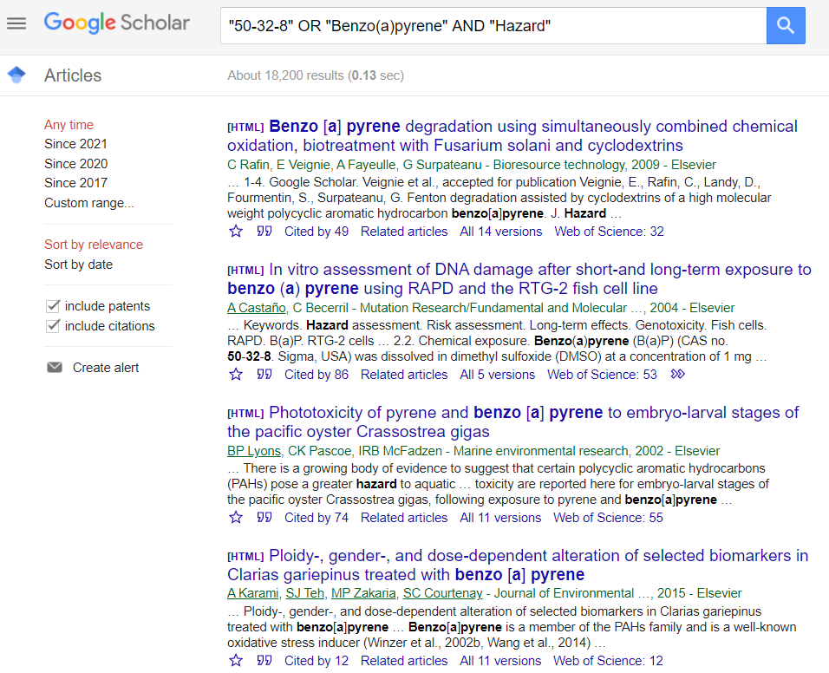
Identifiers are used in the app
Identifiers are used to feed and link into “Literature”

Slide 27
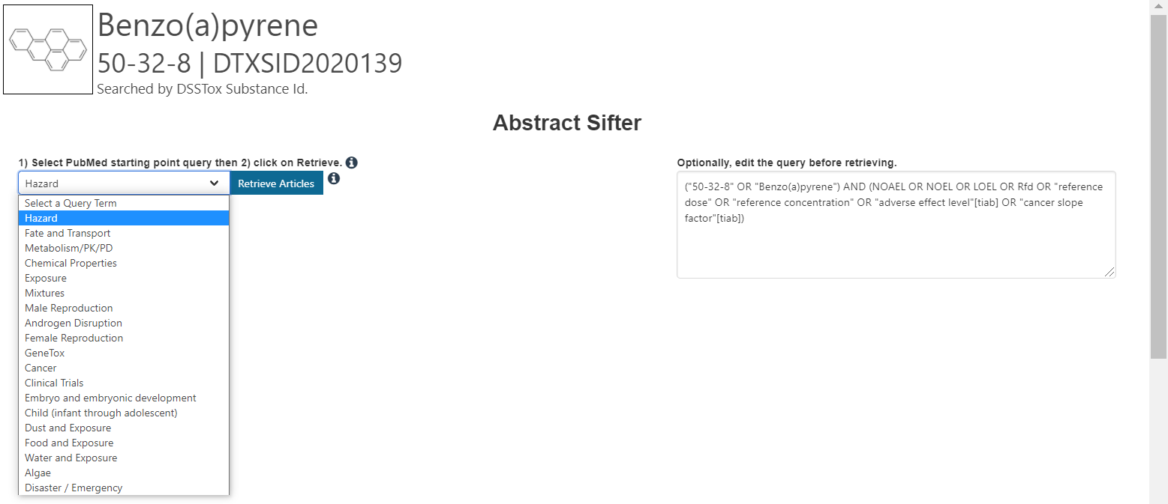
Literature Searching
Real-time retrieval of data from PubMed ~30 million abstracts and growing)
Choose from set of pre-defined queries
Adjust and fine tune queries based on interests

Slide 28
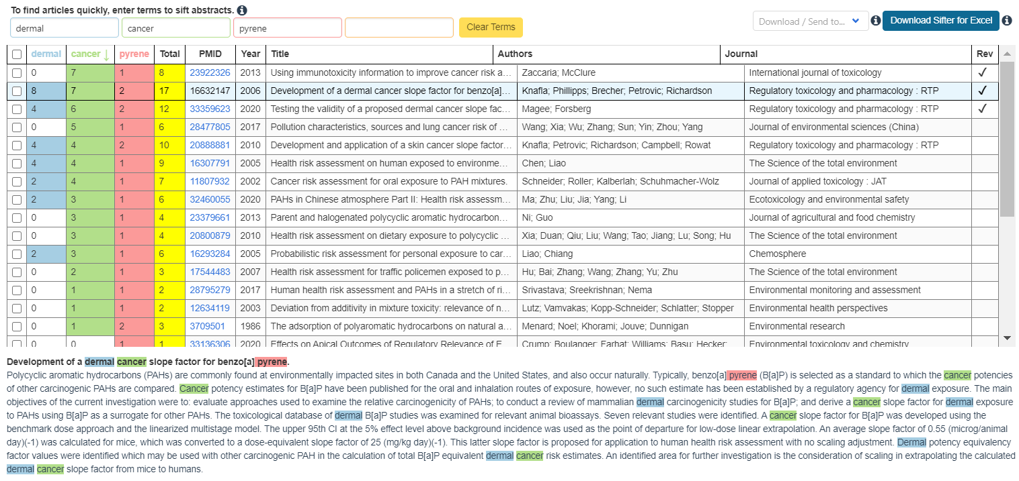
Literature Searching
“Sifting” of results using multiple terms
Frequency counting terms
Color highlighting of terms
Download list to Excel
Send list to PubMed for downloading ref. file
Direct link via PubMed ID

Slide 29
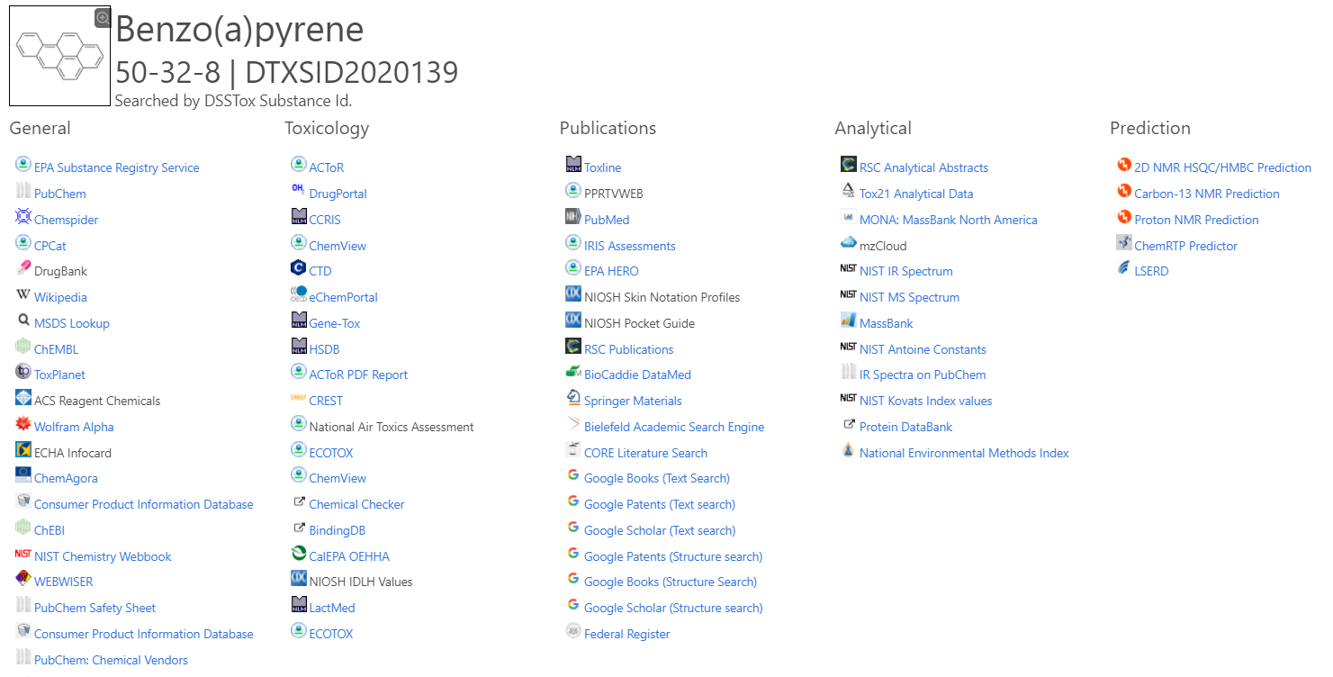
External Links – Also use Identifiers Names, CASRN, PubChem IDs, InChIs…

Slide 30
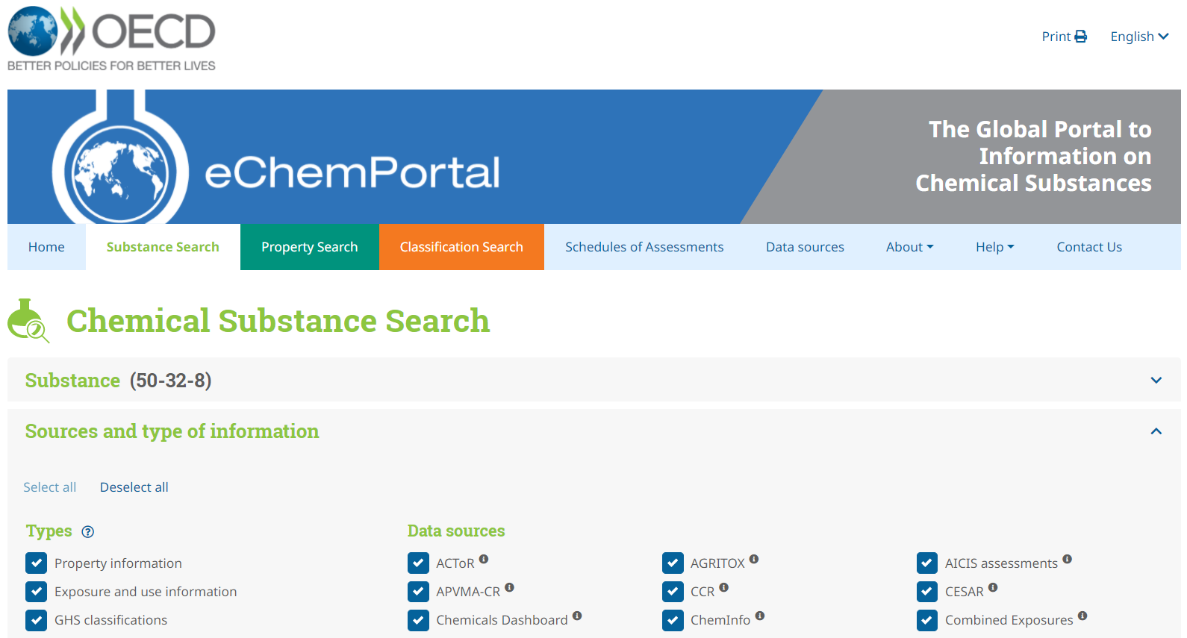
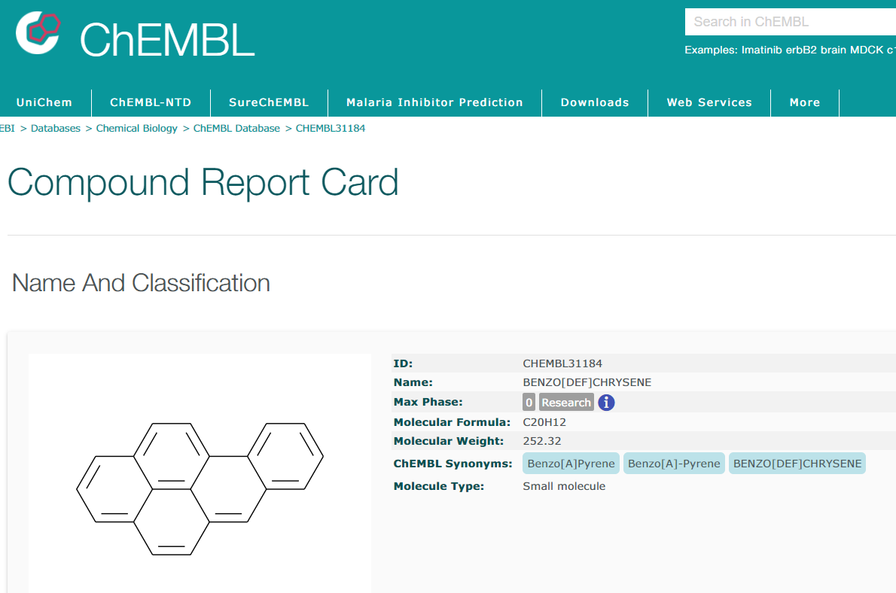
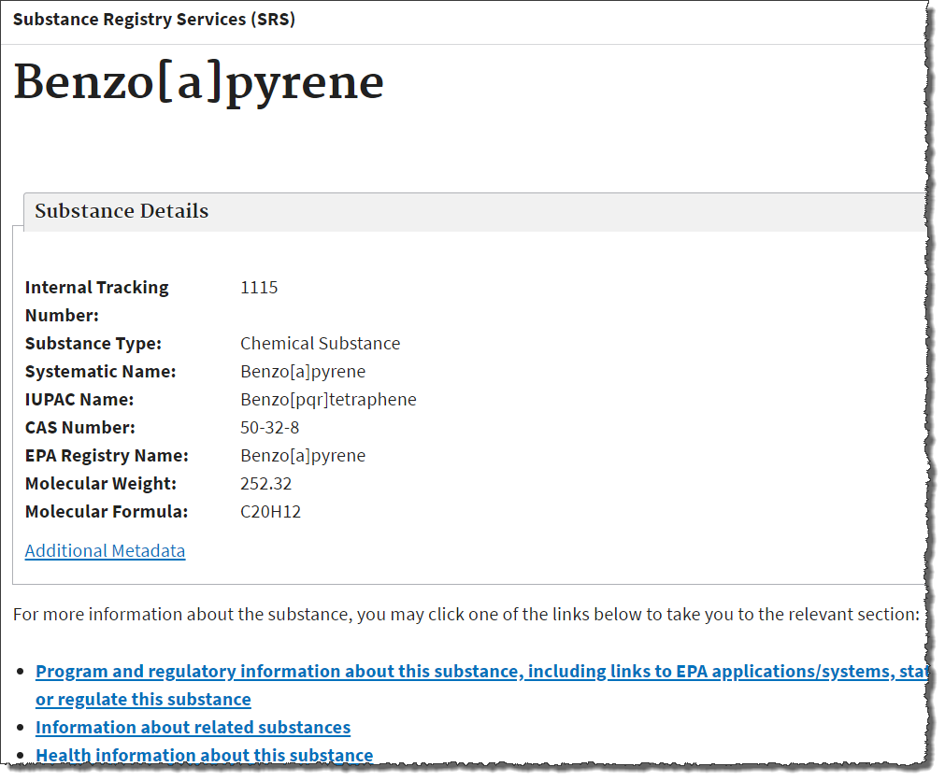
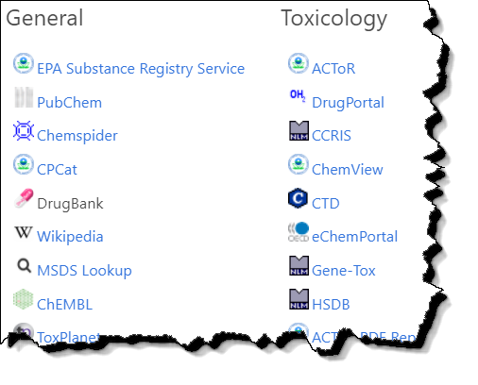
External Links
Links to ~90 websites providing access to additional data on the chemical of interest

Slide 31
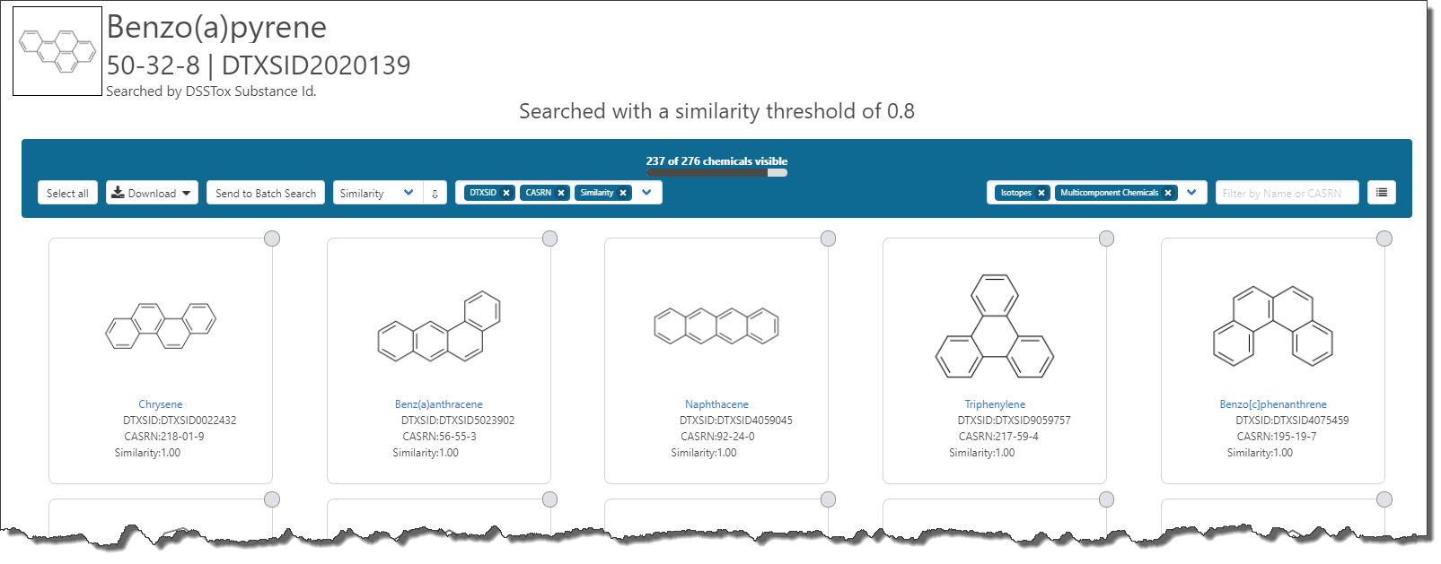
Similarity Searching

Slide 32
Built-in “Modules”

Slide 33
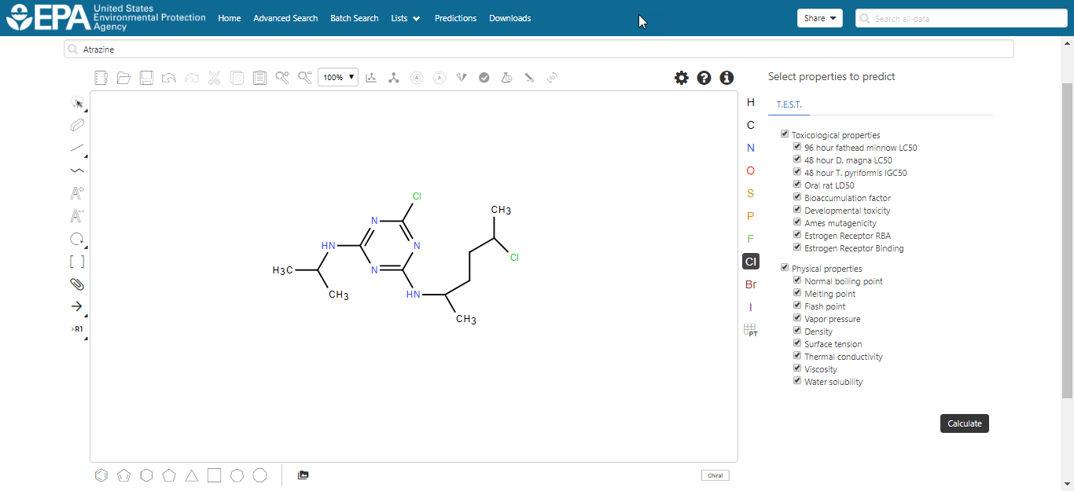
Real-Time Predictions
Input structure using sketcher
Edit chemical
Select endpoints for prediction

Slide 34
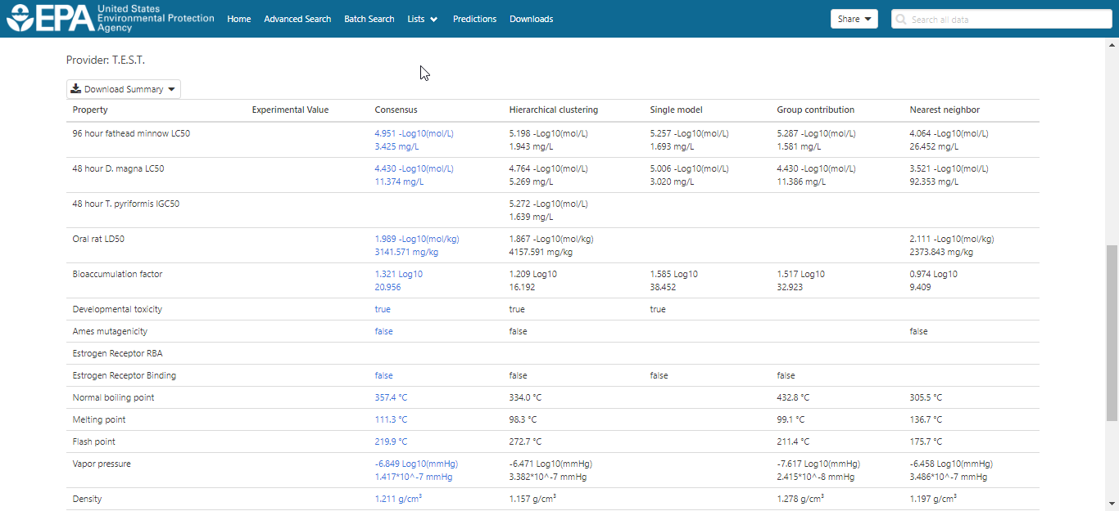
Real-Time Predictions with detailed calculation reports
Four individual models plus consensus model with calculation report

Slide 35
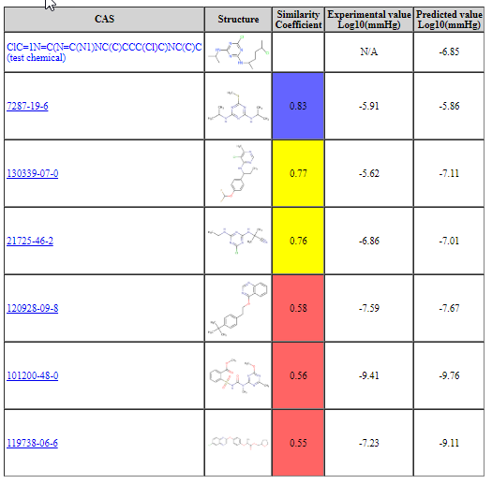
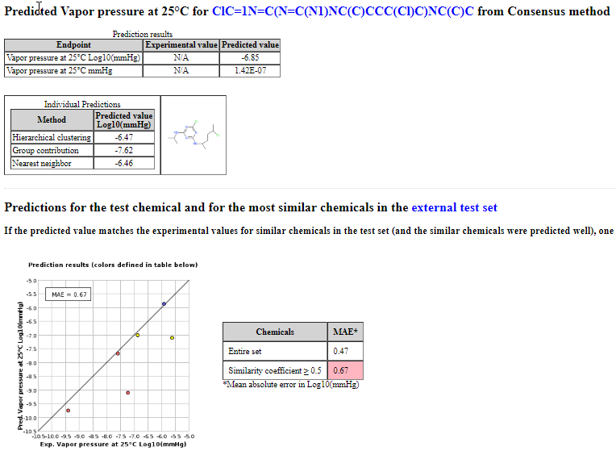
Real-Time Predictions with detailed calculation reports
Full prediction report
Shows chemicals used in training set

Slide 36
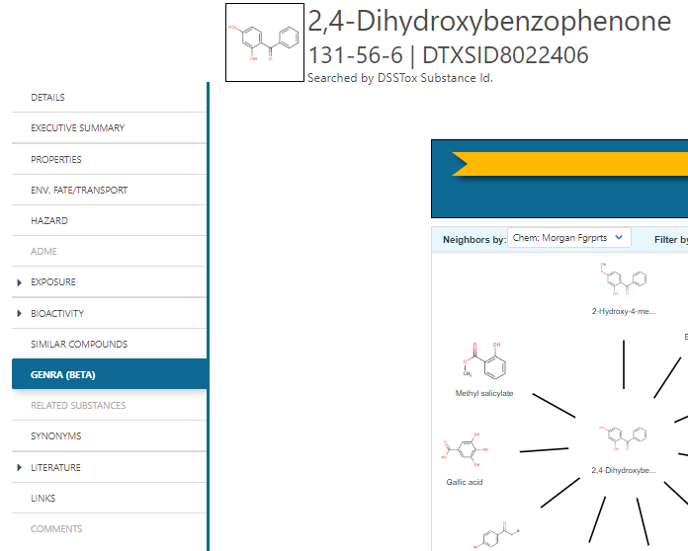
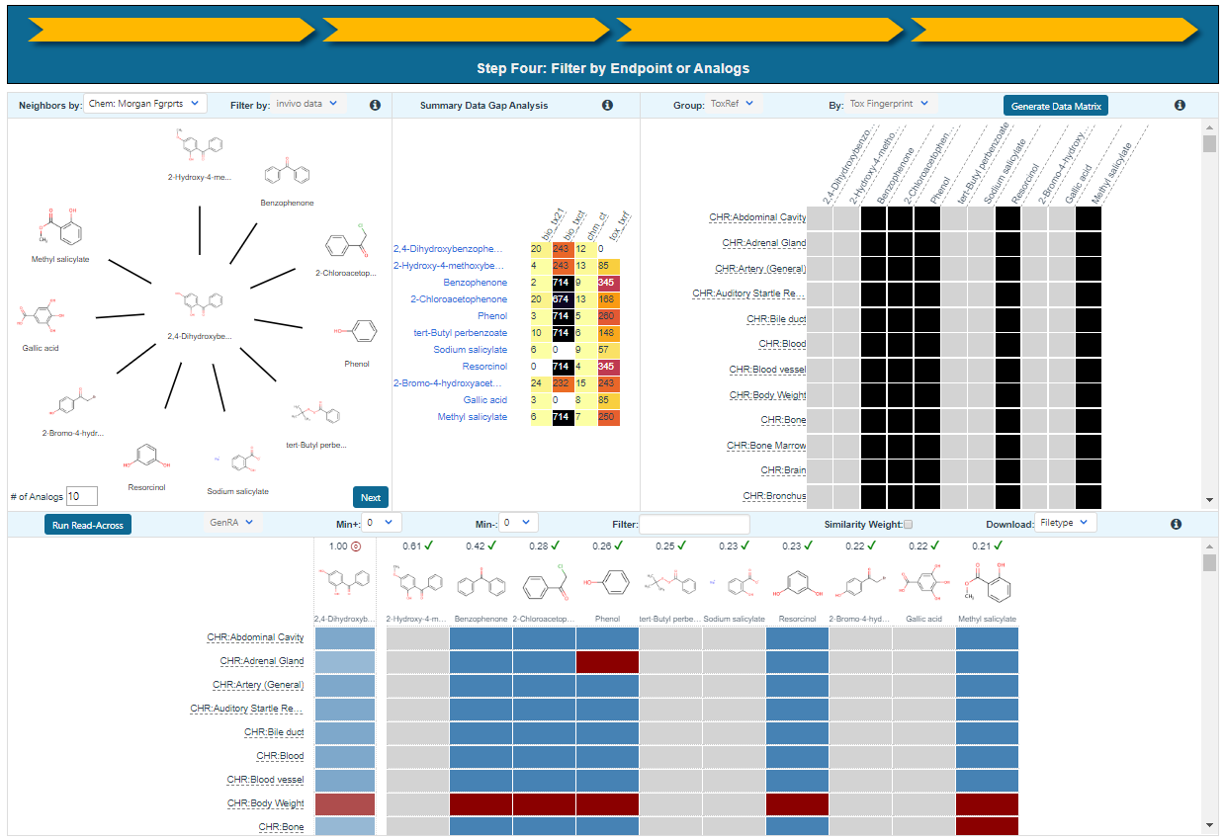
Generalized Read-Across (GenRA)

Slide 37
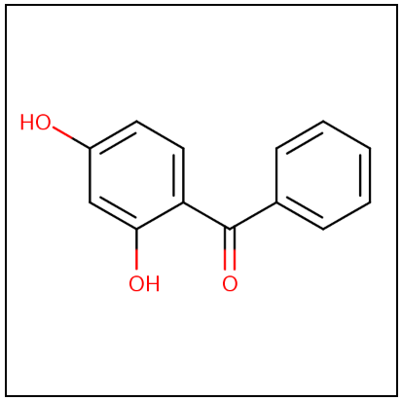
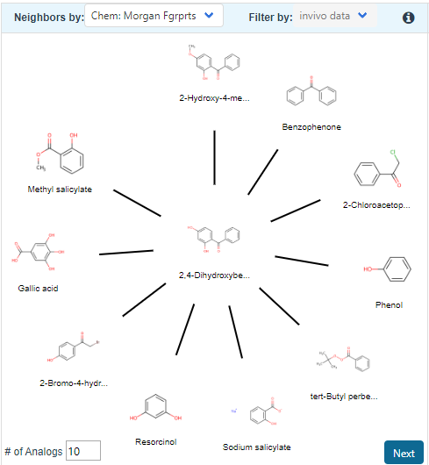
GenRA in practice – step by step
Analogue identification: based on Morgan fingerprints and selecting 10 default analogues

Slide 38
GenRA in practice – step by step
Data matrix view of source analogues relative to target chemical

Slide 39
GenRA in practice – step by step
Updated Data matrix view with GenRA predictions for target chemical
Predictions are binary (yes/no) for toxicity effects
Predictions summarized on study level basis. Red: “positive” and Blue: “negative”.

Slide 40
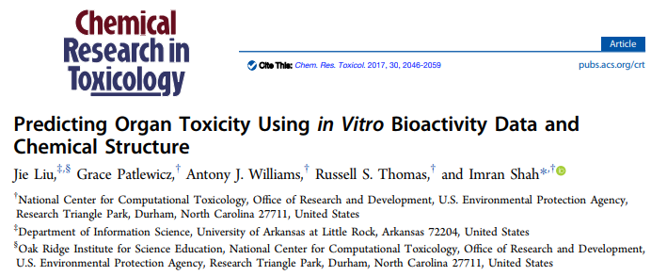
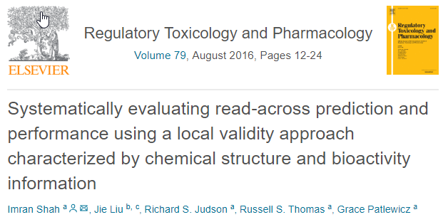
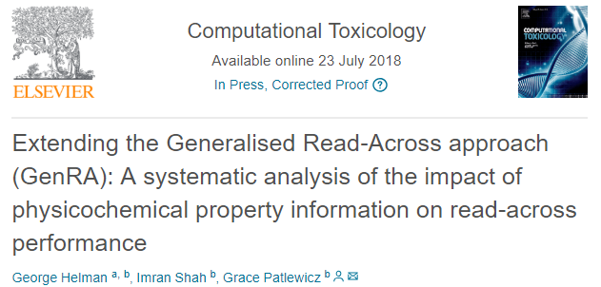
Related Publications

Slide 41
Chemical Lists and Categories

Slide 42
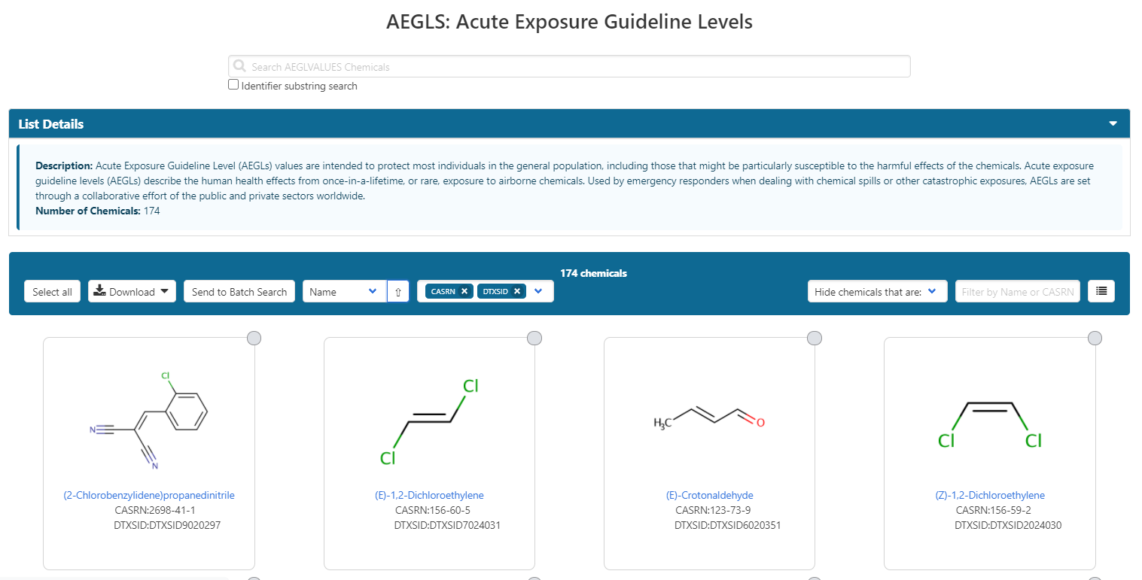
Example: AEGLs list

Slide 43
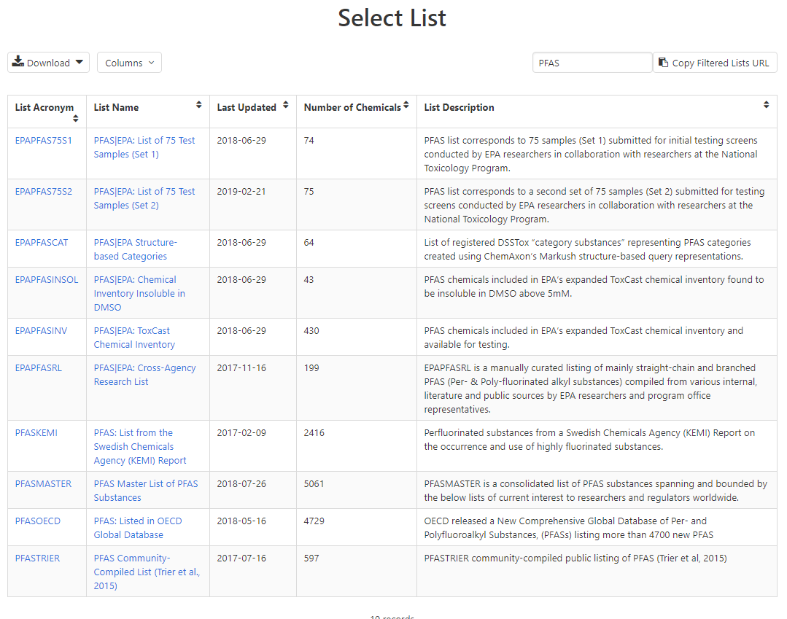
PFAS lists of Chemicals

Slide 44
Batch Searching

Slide 45
Batch Searching
Singleton searches are great but…
…we generally want data on LOTS of chemicals!
Typical questions
What are the structures for a set of chemical names? Set of CASRNs?
Can I get chemical lists in Excel files? As a list of SMILES strings? Can I get an SDF file?
Can I include predicted properties in the download file? OPERA? TEST?
Are “these chemicals” screened in Toxcast?
I’m a mass spectrometrist and need masses and formulae for a list of chemicals

Slide 46
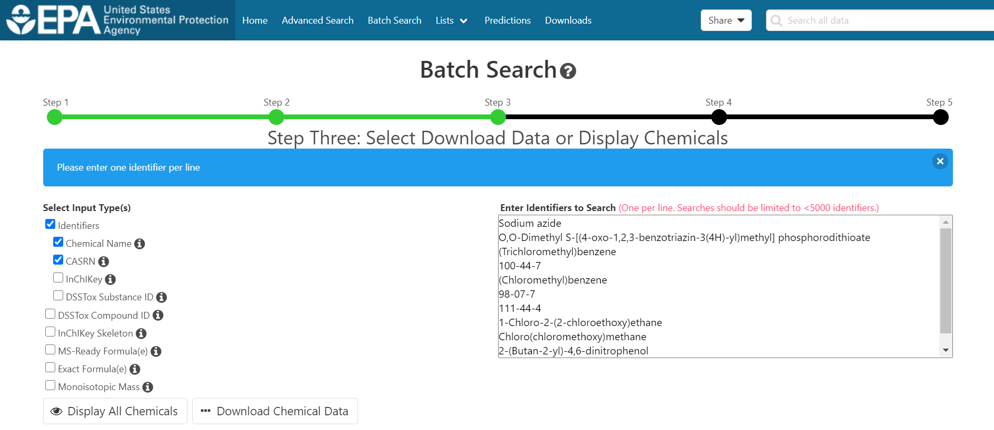
Access data en masse for thousands of chemicals….

Slide 47
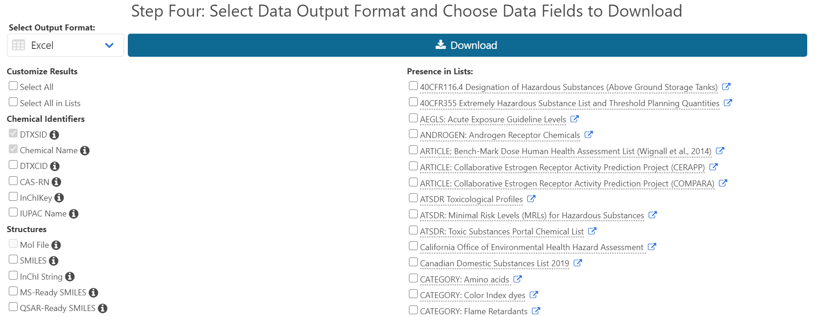
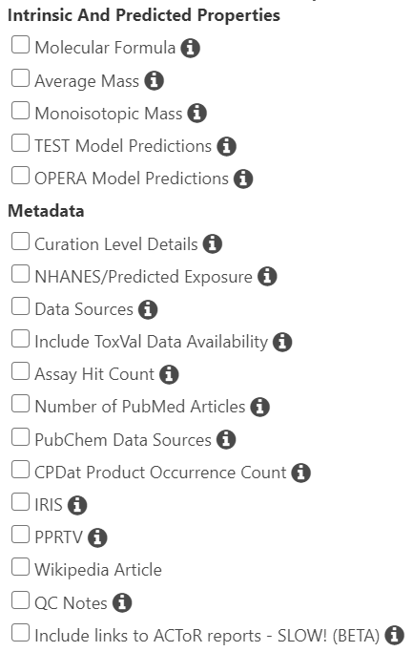
Select Output Format and Content

Slide 48
Batch Search CASRNs

Slide 49
Batch collection of data for a set of pesticides

Slide 50
Curated List of Pesticides
Find list of interest
Select list and send to batch

Slide 51
Send to batch and select….
A few seconds to assemble
ToxCast data - #actives/#assays and % active
# articles in PubMed
Links to IRIS or PPRTV reports
TEST or OPERA predictions
Exposure data: predictions and CPDat

Slide 52
Summary and Conclusion
CompTox Chemicals Dashboard - a central hub for environmental data
~875k chemical substances
Integrating property data, hazard data, exposure data, in vitro bioactivity data
Interrogation of bioactivity data -
Multiple types of searches
Batch search for thousands of chemicals
Real-time property and toxicity predictions
Downloadable files – CSV, TSV and Excel

Slide 53
References
The CompTox Chemistry Dashboard: a community data resource for environmental chemistry, J. Cheminformatics, 9, 61 (2017)
EPA’s DSSTox database: History of development of a curated chemistry resource supporting computational toxicology research, Comp. Tox. 12, 100096 (2019)
OPERA models for predicting physicochemical properties and environmental fate endpoints, J. Cheminformatics, 10, 10 (2018)
Screening Chemicals for Estrogen Receptor Bioactivity Using a Computational Model, Environ. Sci. Technol. 49, 8804-8814 (2015)
ToxCast Chemical Landscape: Paving the Road to 21st Century Toxicology, Chem. Res. Toxicol. 29, 1225-51 (2016)
Development and Validation of a Computational Model for Androgen Receptor Activity, Chem. Res. Toxicol. 30, 946-964 (2017)
CERAPP: Collaborative Estrogen Receptor Activity Prediction Project, Environ. Health Perspect. 124, 1023 (2016)
Abstract Sifter: a comprehensive front-end system to PubMed, F1000, 6, 2164 (2017)

Slide 54
You want to know more…
Lots of resources available
Presentations: https://tinyurl.com/w5hqs55
Communities of Practice Videos: https://rb.gy/qsbno1
Manual: https://rb.gy/4fgydc
Latest News: https://comptox.epa.gov/dashboard/news_info

Slide 55
Acknowledgments
Contact: Williams.Antony@epa.gov
Feedback and follow-up is welcomed! Your questions help
The dashboard is based on the efforts of many more team members than us. Many collaborators provide data also.
EPA’s Center for Computational Toxicology and Exposure

